Slide 1

THE A.I.
“NEW NORMAL”
EVALUATING THE
USES AND ETHICS OF
ARTIFICIAL INTELLIGENCE
IN ADVANCED STRING TEACHING
Miranda Wilson, DMA
Professor of Cello
University of Idaho, USA

Slide 2



WHAT WE’RE UP AGAINST:
SUNO VS. SWAN
Images: Wikimedia Commons and Suno, Inc.

Slide 3




TECHNOLOGY-ASSISTED PRACTICE TOOLS
Images: MakeMusic, Tonestro, Violy, Trala

Slide 4
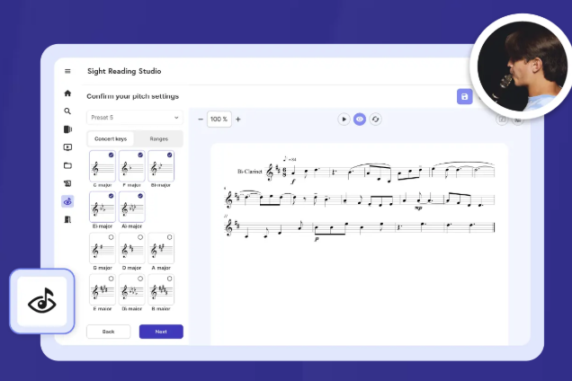
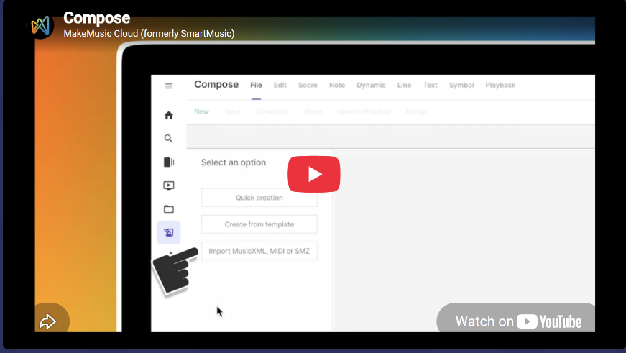
TECHNOLOGY-ASSISTED PRACTICE TOOLS:
makemusic
Images: MakeMusic

Slide 5
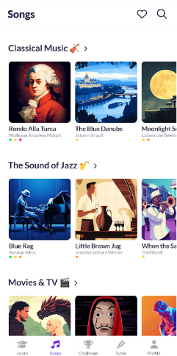
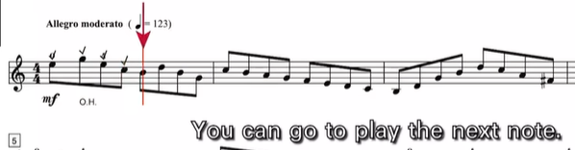
TECHNOLOGY-ASSISTED PRACTICE TOOLS: violy
Images: Violy

Slide 6
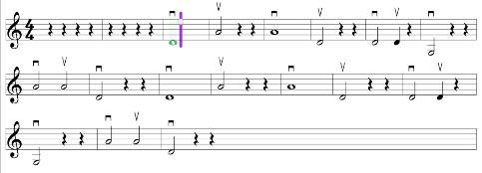
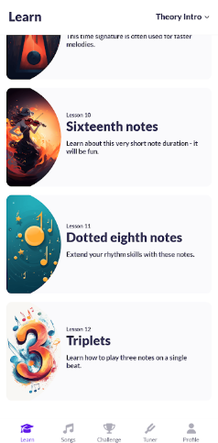
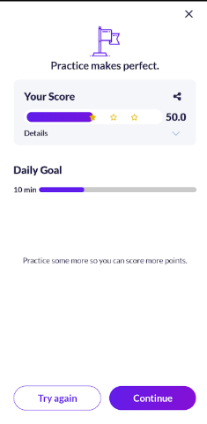
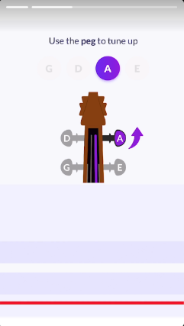
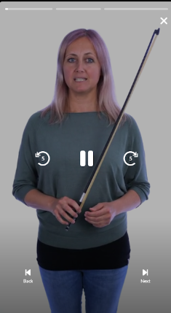
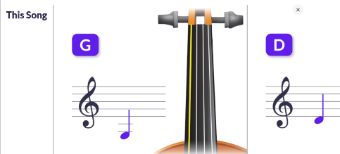
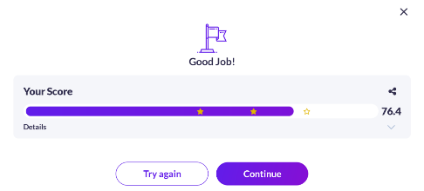
TECHNOLOGY-ASSISTED PRACTICE TOOLS: tonestro
Images: Tonestro

Slide 7
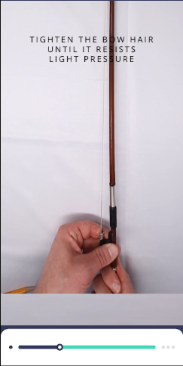
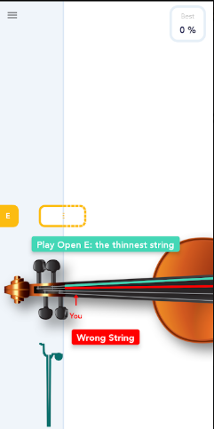
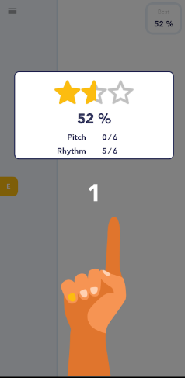
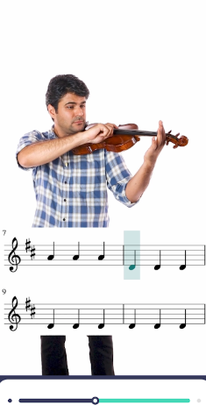
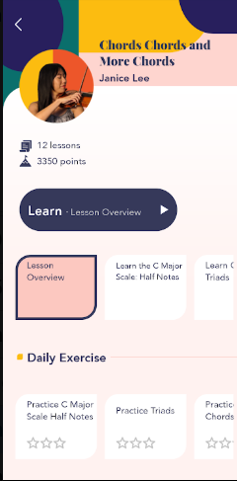
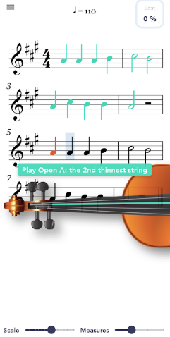
TECHNOLOGY-ASSISTED PRACTICE TOOLS: trala
Images: Trala

Slide 8
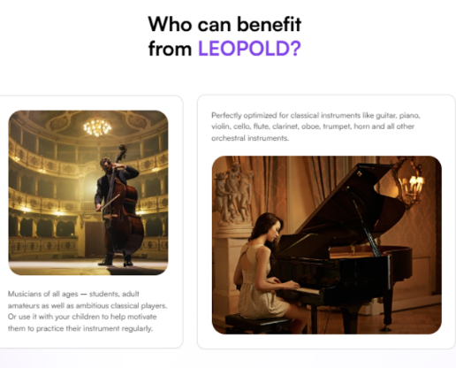

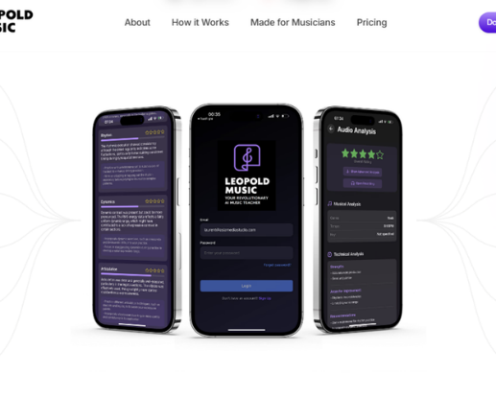
LEOPOLD-AI.COM
Images: Leopold-AI

Slide 9
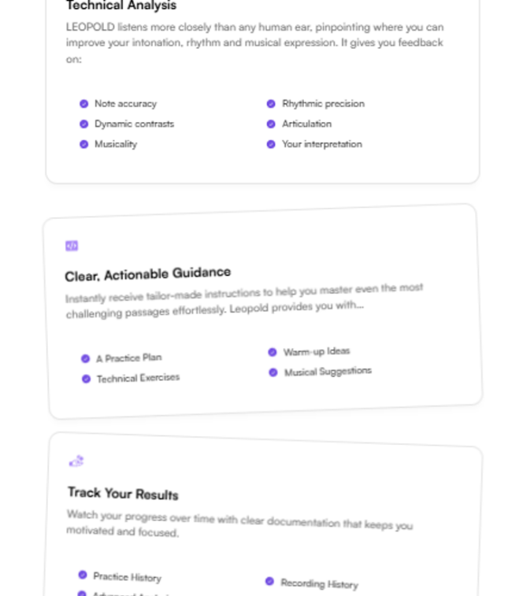
features
  Upload
  Analysis
  Scoring
  Practice Plan
  Advanced Analysis
Image: Leopold-AI

Slide 10
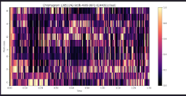

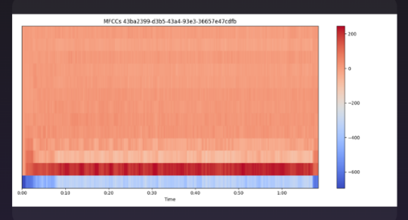
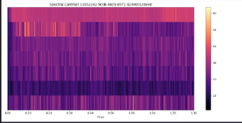
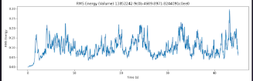
Advanced features
    Chromagram Spectral Centroid Mel-Frequency
    Cepstral Coefficients
    Spectral Contrast Root Mean Square Energy
Images: Leopold-AI

Slide 11
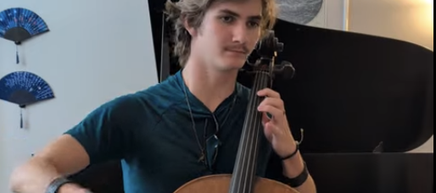
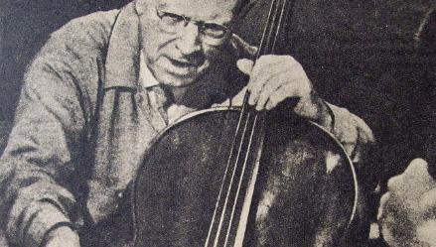
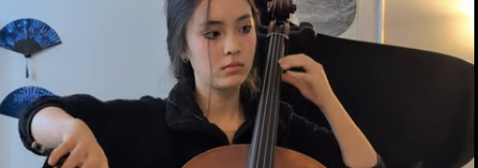
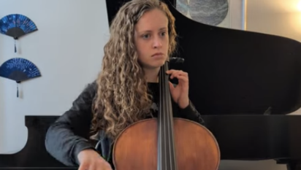
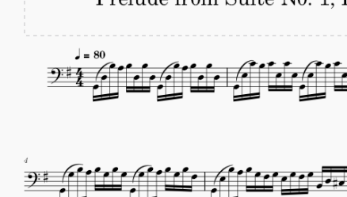
METHODOLOGY

Slide 12
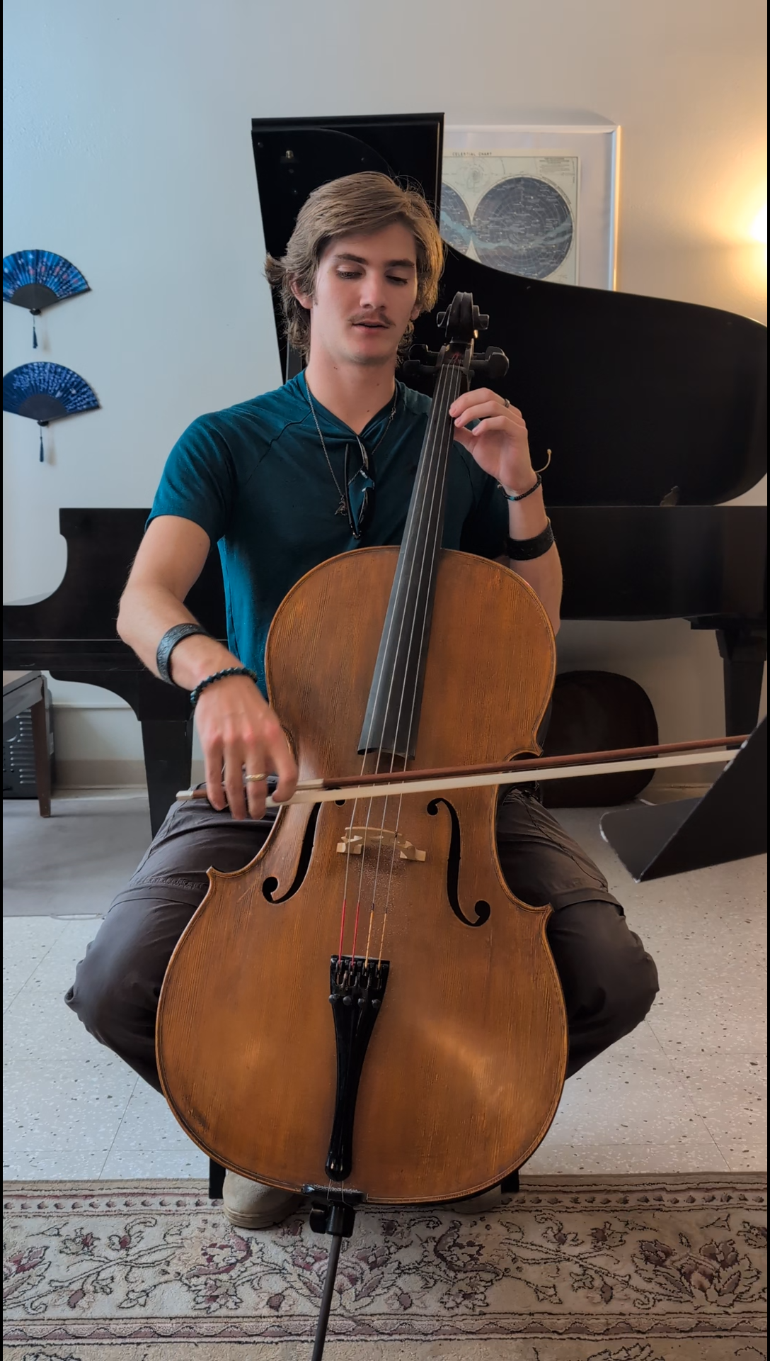
Student 1
(18 years)

Slide 13
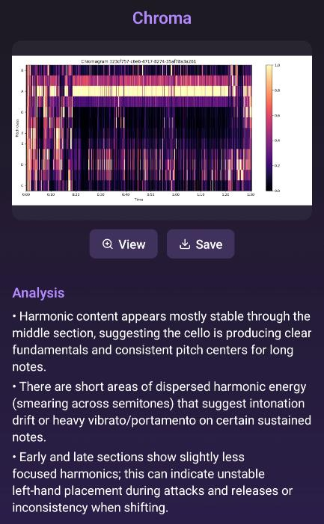
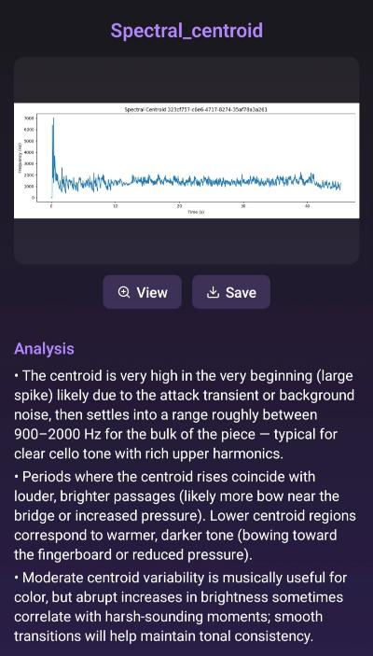
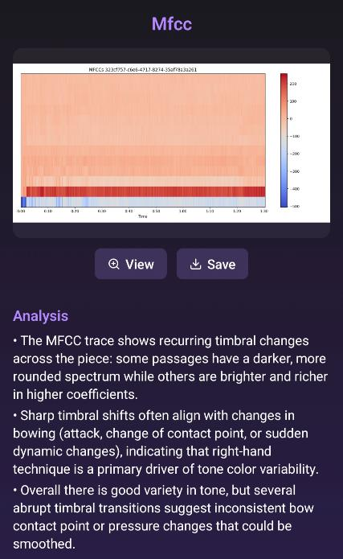
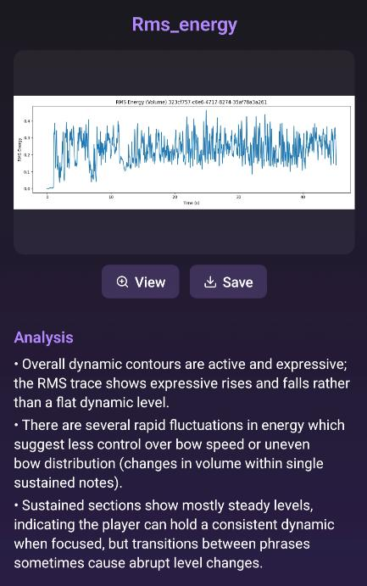
Student 1 feedback
Images: Leopold-AI

Slide 14
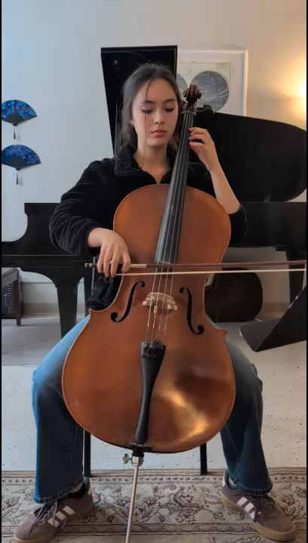
Student 2
(17 years)

Slide 15
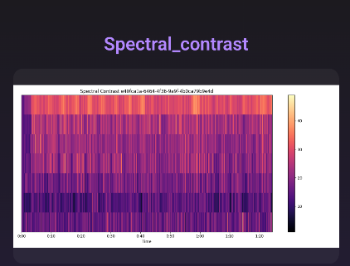
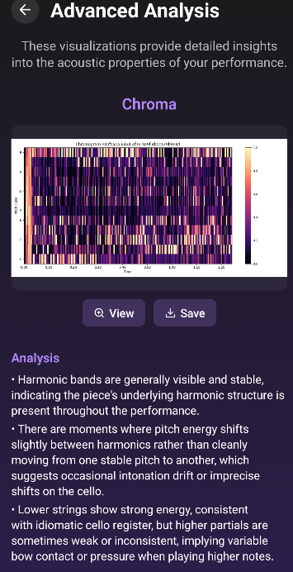
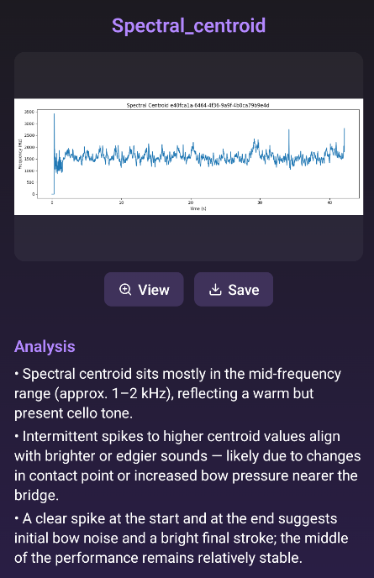
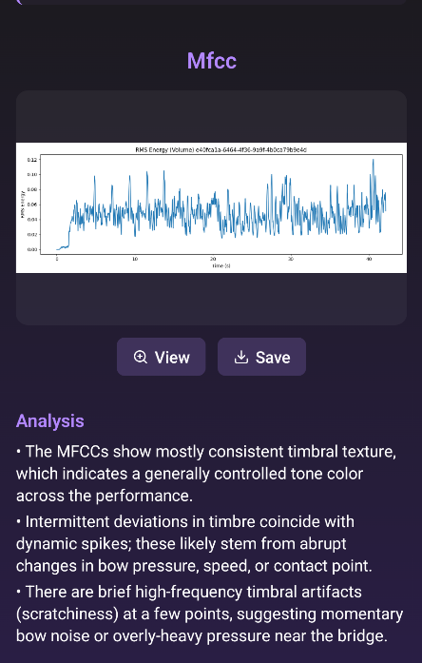
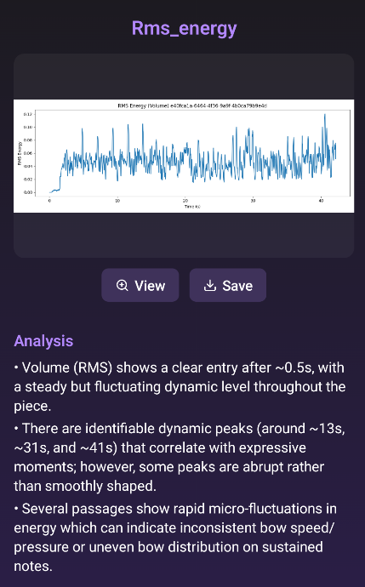
Student 2 feedback
Images: Leopold-AI

Slide 16
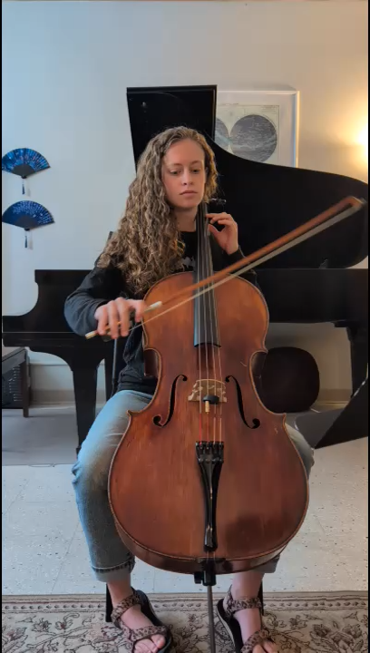
Student 3
(20 years)

Slide 17
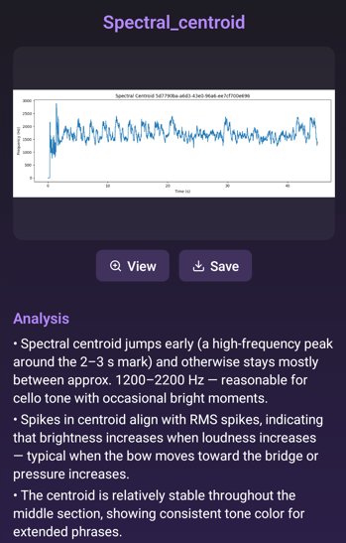
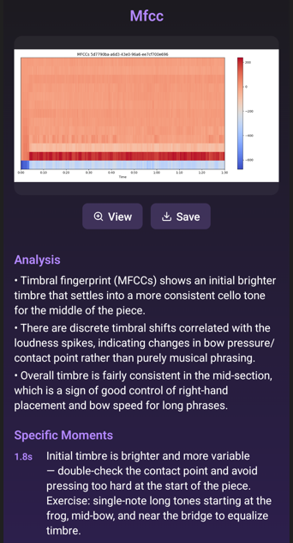
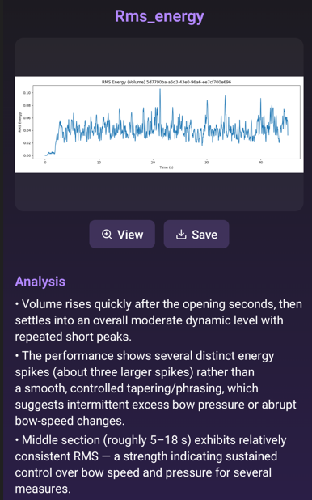
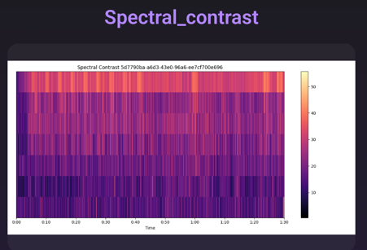
Student 3 feedback
Images: Leopold-AI

Slide 18
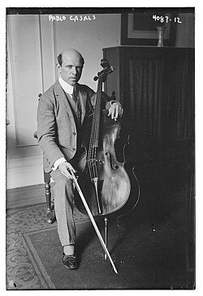
PABLO CASALS
Images: Library of Congress

Slide 19
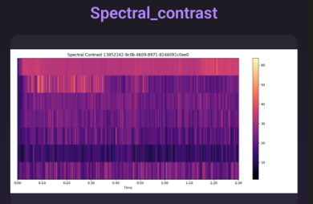
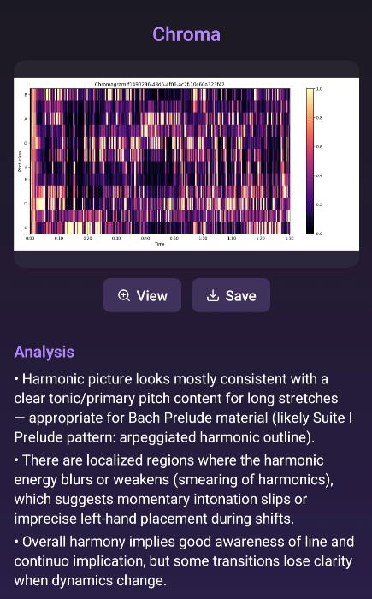
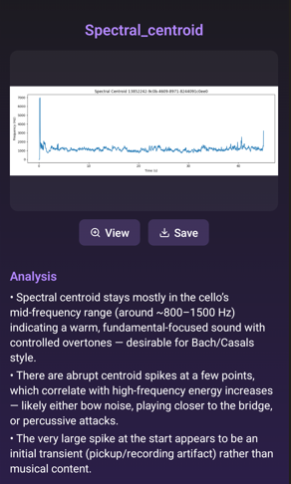
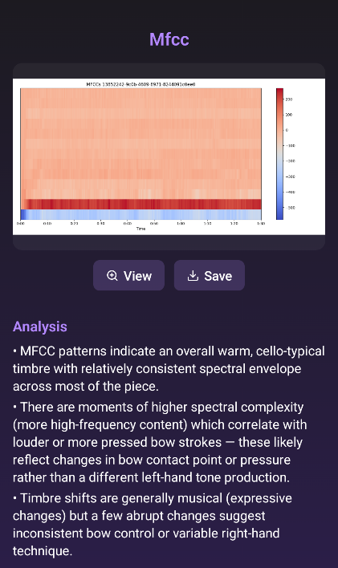

Casals feedback
Images: Leopold-AI

Slide 20

Midi file

Slide 21




midi feedback
Images: Leopold-AI

Slide 22






















Side-by-side graphs
Student 1 student 2 student 3 Casals midi
Chroma (not given) (Not given)
Spectral
centroid
Mfcc
Rms
Spectral (not given)
contrast
Images: Leopold-AI

Slide 23
COMPARATIVE SCORES
 | Note accuracy | Rhythm | Dynamics | Articulation | Overall score out of 5
Student 1 | 3/5 | 4/5 | 3/5 | 3/5 | 0.5
Student 2 | 3/5 | 4/5 | 3/5 | 3/5 | 0.5
Student 3 | 3/5 | 4/5 | 3/5 | 3/5 | 0.5
Casals | 3/5 | 3/5 | 3/5 | 3/5 | 0.5
MIDI | 3/5 | 3/5 | 3/5 | 3/5 | 0.5

Slide 24
CONVERSATION WITH DEVELOPERS
  Motivation
  Training data
    Written
    Audio
  Graph interpretation
  Future plans

Slide 25


EXISTING ALTERNATIVES
Images: MREMG.com, TonalEnergy Inc.

Slide 26






Unintended uses
Images: Wikimedia Commons

Slide 27

Future developments
Image: University of Maryland

Slide 28

conclusions
  mirandawilsoncellist.com
  mirandaw@uidaho.edu

